Slide 1
Understanding Quorums
Hannover Bitcoin Meetup 2019-04-24

Slide 2
What is the Problem?
Thin Clients (called SPV for Simplified Payment Verification) need to connect to a full node to do anything useful (send, sign, check blocks, verify, etc.)
Private keys stay with the client, but there are always trust issues for any advanced feature
For this reason many features are simply not possible
Anything involving past blocks
Smart Contracts
Privacy (both linking users to IP addresses and preventing most privacy features)
Discover nodes and Peer To Peer in general
You need the hard-wired full nodes to be online, otherwise your thin client doesn’t work
See “On the Privacy Provisions of Bloom Filters in Lightweight Bitcoin Clients” https://eprint.iacr.org/2014/763.pdf

Slide 3
Who is affected?
Anyone using any cryptocurrency on a phone
– none of them are full nodes due to memory and performance
Anyone using a thin SPV client like
– Jaxx – Electrum – Coinomi – etc.
This includes all Hardware Wallets as well as they have no full node functionality either!

Slide 4
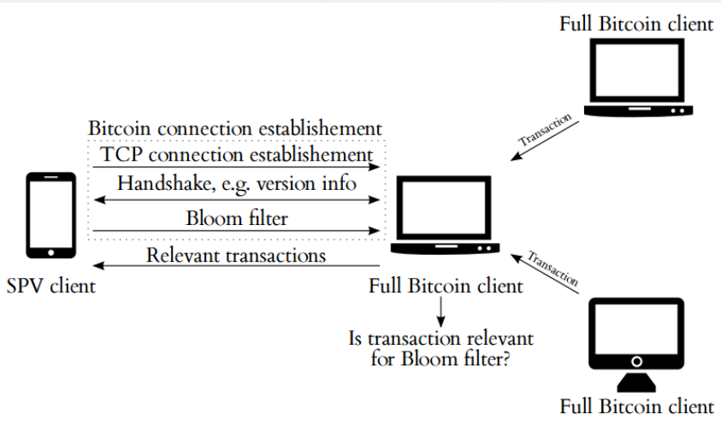
How SPV clients work

Slide 5
SPV Problems and Possible Attacks
An attacker might
– Spoof some full nodes – Block some SPV requests – Spoof some SPV requests – Sniff some SPV requests – Block some SPV answers
But spoofing full answers isn’t possible because of transactions hash verification
Most possible attacks are LAN attacks against SPV user or full Bitcoin node

Slide 6
Example: Lan Attack
If the attacker is on the same local network as the victim:
– Prevent any (full or light) node from working (denial of service) – Spoof any node request/response – Spoof any unprotected request (HTTP) to a Bitcoin explorer API or web site
A lot of techniques can be used: – ARP cache spoofing/poisoning – DNS cache spoofing/poisoning – DHCP spoofing – ICMP redirect – MAC flooding
Want to know more? Check https://breaking-bitcoin.com/slides/SPVSecurity.pdf

Slide 7
Privacy Issues
● SPV queries can be quite easily sniffed
● An attacker might associate user IP address, submitted Bloom filters and downloaded transactions to know all addresses of a given user
● See “On the Privacy Provisions of Bloom Filters in Lightweight Bitcoin Clients” (by Gervais et al.): https://eprint.iacr.org/2014/763.pdf

Slide 8
End User Solutions
● Don’t use SVN at all (not very practical, most users use thin clients)
● Use a VPN, or better a VPN connection to your own full Bitcoin node
● Don’t directly use hardcoded nodes or DNS seeds (but use their direct or indirect neighbors)
● Cross-check with requests to a clean blockchain explorer API (HTTPS only, public CA, use of CRL) : tx count, balance, ...

Slide 9
Pretty Bad State of Affairs, Is Anyone working on a Solution?
● There is no easy solution to this, cryptography and security is always hard, especially if things get more complex
● The only project I am aware of trying to fix all this is Dash
Meet Quorums: A deterministic collection of nodes to do stuff on the blockchain in a trustless manner (vote, sign, mix, check for double spend, 51% attacks prevention, InstantSend, Smart Contracts, Database Storage, find and lock in the longest chain, etc.)
● In the past not much could be improved without adding new trust issues
If you add new features like VPN/TOR/more Full Nodes into SPV clients, you create more attack surfaces and usually more services and endpoints = more attack surfaces

Slide 10
What are Quorums?
A quorum is a collection of entities that are able to vote on something. Every member is generally allowed to vote only once. If >= 51% vote for the same thing, majority is reached. Something either got the majority of votes or not, there should be nothing in between.
This is useful if the likelihood of disagreement is too high, which for example is the case when it comes to propagation of transactions and handling of conflicts if they arise. Bitcoin introduced a policy to handle this, which is the first-seen policy. Dash inherited this policy. It basically means that if a conflict arises (e.g. a double spending transaction) the first seen transaction is the only one a node should accept and propagate while ignoring all others.
This removes all ambiguity on a single node, including miners. It also reduces ambiguity on the whole network, as it also means that a transaction that is well propagated can’t be replaced by a conflicting one. If however, a transaction is not well propagated yet, two competing transactions will start to race in the network, resulting in one part of the network seeing one of the transactions first, and the other part of the network seeing the other transaction first. In the end, it’ll be impossible to tell which of both transactions is going to be mined and confirmed on-chain. This is because a single node can not know what the other nodes have seen first.

Slide 11
InstantSend solved this 4 years ago
Dash has already solved this problem thanks to InstantSend back in 2015. InstantSend is the first time we used quorums to solve such ambiguity in the network. It works by choosing a new quorum of 10 masternodes per transaction input and letting every member sign and propagate a vote for it. If 6 out of these 10 do this, we can be pretty sure that the majority of the network has also seen this transaction first. If this is the case, a node can safely reject all other transactions conflicting with that one, even if they were locally seen first. If some race had happened between two conflicting transactions, only one of both would have been able to reach more than the other one.

Slide 12
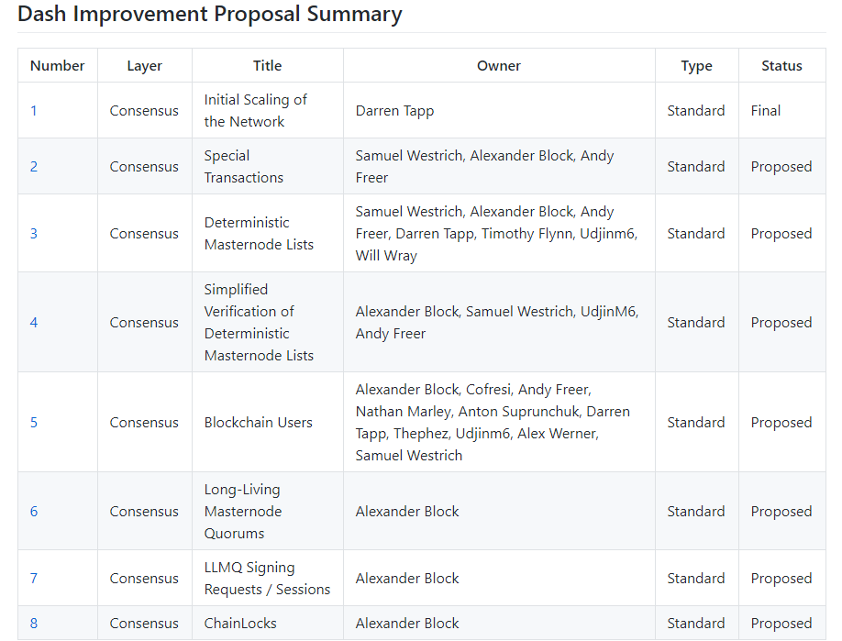
DASh 0.13 DIP3 adds Special Transactions
Took a long time, but with the Dash 0.13 release in March and Activation Early April 2019, DIP3 Special Transactions are now live and Quorums can be used, already used for: - Masternode registrations - Masternode lists, syncs, etc. - InstantSend - LLMQ ChainLocks (0.14 testnet) - LLMQ InstantSend chaining (0.14 testnet)
Some of these can be seen with our explorer (and testnet explorer): https://explorer.MyDashWallet.org

Slide 13
The basis for better SPV Clients can be found in DIP3 Special Transactions
DIP3 provides on-chain consensus for masternode lists that in turn allow for deterministic quorum derivation and service scoring of masternode rewards in Dash.
[…] When quorums were used, for example in InstantSend, nodes would sometimes calculate a different quorum set for an InstantSend lock resulting in partially failed locks. This was mostly non-problematic due to the size of the quorum and the quorum selection algorithm, but could still potentially result in individual nodes forking away from the network.
The previous system also made certain desirable features infeasible. The integration of a service score was near impossible without a certain consensus. A hardened masternode list also expands on possible system capabilities.
In the new system, the masternode list is derived entirely from information found on-chain. New masternodes are added by new special transactions called Provider Registration Transactions (abbreviated as ProRegTx). They are only removed by spending the collateral. […]
More details: https://github.com/dashpay/dips/blob/master/dip-0003.md#selecting-quorums

Slide 14

Selecting Quorums
SPV clients can now select a deterministic random number of nodes no one can modify and perform any action:
- Send, Sign, Verify
- InstantSend
- Privacy (Mixing, this is actually the part we will be working on Summer 2019)
- Store data/smart contracts/DashPay usernames (late 2019), etc.

Slide 15
Questions?
As always, you can download the presentation at:
https://github.com/BenjaminNitschke/BitcoinMeetupHannover
We are looking for C# Developers, feel free to apply:
Jobs@DeltaEngine.net
https://www.linkedin.com/jobs/cap/view/1207918629/

